Slide 1
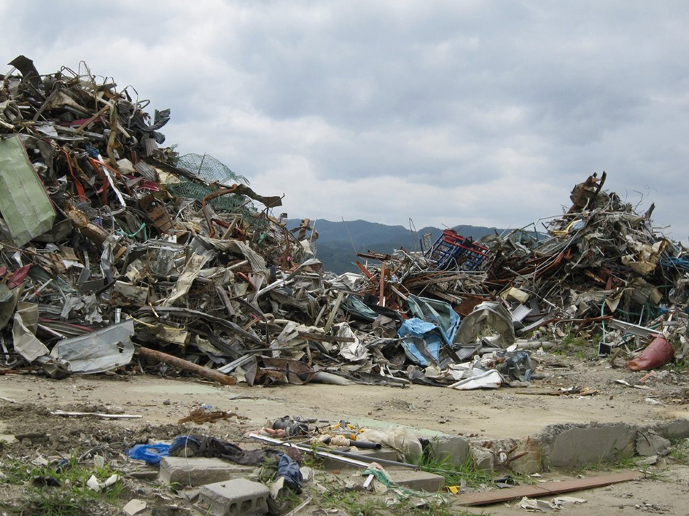
Meta and Longitudinal Analyses of High Death Rates of Some Particular Municipalities in GEJET
ICHARM International Centre for Water Hazard Risk Management under the auspices of UNESCO
CTI Engineering Co., Ltd. Japan
2011.７.21

Slide 2
IRDR (Integrated Research on Disaster Risk)
Working Groups
Forensic Investigations
Meta-Analysis
Longitudinal Analysis
Critical Cause Analysis
Scenario Analysis
Risk Interpretation and Action
Disaster Loss Data

Slide 3
Purpose
Utilizing Meta and longitudinal Analyses, we try to examine:
Why some municipalities had high human losses and the others less?
Where those differences come from?
Identify the Uniqueness of High Human Losses of Particular Municipalities

Slide 4
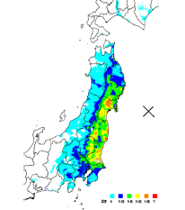
Over view of GEJET in 2011
M 9.0
Death Toll 15,690 Missing 4,735
Completely Destroyed House 112,901
A Partly Destroyed House 144,598
(2011.10.12)
Non Tsunami Affected Area 94 (0.5%)
Tsunami Affected Area 20,329 (99.5%)
Epicentral Area (Wave Source Area) :
Extending 200 km east to west by 500 km north to south < From off the coast of Hachinohe to off the coast of Kashima >
Tsunami Arrival :
Approx. 30min. to 2.5hr (From north <South Sanriku> to south <South Boso Peninsula>)
Tsunami Height
Tsunami Height :
North of Iwate Prefecture to
Ozika Peninsula (220km) :
Ria Coastline 20-30 m
Max.40m
South of Ozika Peninsula to
Iwaki (150 km) :
Straight Coastline 10-20 m
Ibaraki Pref. and Chiba Pref.
5-10 m
Aomori 5m

Slide 5
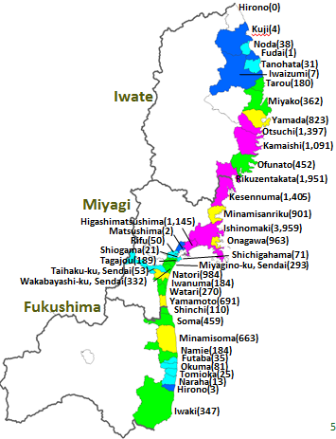
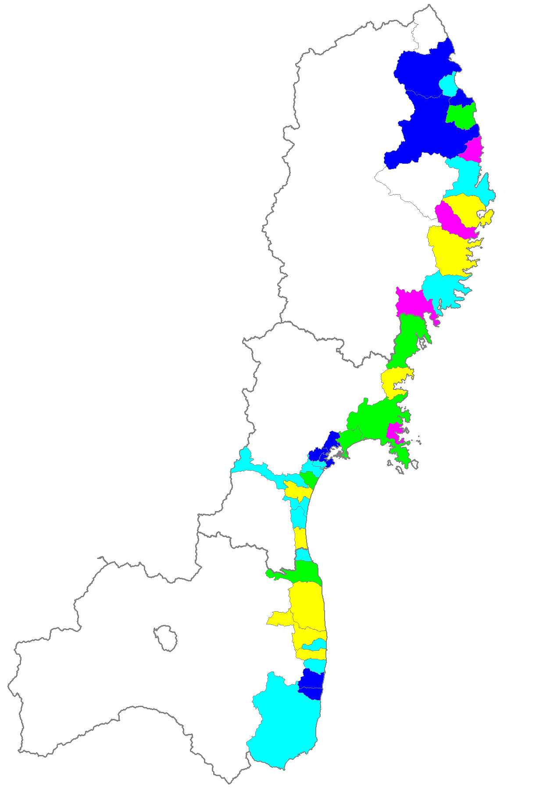
Over view of GEJET in 2011
Death Number
Human Loss Ratio (IA)
<(Death Number / Population) in each Municipalities Inundated Areas>
Death Ratio
Source : FDMA（9Sep.2011）
Notes:
説明、書き込む Whyを記入 これらを明らかにするｌ。
5

Slide 6
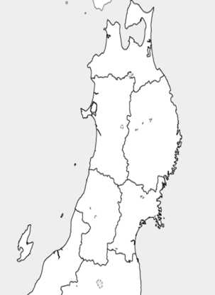
Human Loss Ratio : Sanriku Ria Coastal Area
 | Dead- Missing | HLRatio (IA) | HLratio | IA (km²)
Kuji | 4 | 0.06% | 0.01% | 4
Noda | 38 | 1.2 | 0.8 | 2
Fudai | 1 | 0.9 |  | 1
Tanohata | 33 | 2.1 | 0.9 | 1
Iwaizumi | 7 | 0.6 | 0.1 | 1
Miyako | 544 | 3.0 | 1.0 | 10
Yamada | 853 | 7.5 | 4.6 | 5
Otsuchi | 1449 | 12.2 | 10.6 | 4
Kamaishi | 1180 | 9.0 | 3.1 | 7
Ofunato | 449 | 2.4 | 1.1 | 8
Rikuzentakata | 2115 | 12.7 | 8.6 | 13
Kesennuma | 1414 | 3.5 | 1.9 | 18
Minamisanriku | 987 | 6.9 | 5.7 | 10
Onagawa | 949 | 11.8 | 9.2 | 3
Total/Average | 10023 | 6.0% | 2.8% | 88
Morioka
Iwate
Sendai
Miyagi
Fukushima

Slide 7
Methodology (How to investigate)
Meta-Analysis : Literature survey and statistical analysis
Longitudinal Analysis : Comparative studies of a set of target areas by
temporal and historical perspective.
Data Source for this Study
<Open Source Data>
1. Central Gov. / 2. Regional Gov. / 3. Organizations / 4. Libraries
internet source, major newspapers, statistical data, raw data
historical documents, historical statistics, local newspapers, vernacular magazines
※ <Closed Source Data>
Field survey data mainly can be utilized for critical cause analysis
Major Source for this Study (Mainly in Japanese)
General info : Cabinet Office, Ministry of Internal Affairs and Communications,
Fire Defense Agency
Victims related info : National Police Agency
Geographical info : Geospatial Information Authority of Japan
Local info : Iwate Prefectural Gov., Iwate fukko net, Iwate Statistics Data Base
Historical info : Japan Destructive Earthquake General Survey(Usami, 2003)
Japan Maps Encyclopedia(Yamaguchi et al., 1980)

Slide 8
Methodology (What do we investigate?)
Investigate Human Loss Ratio (IA) in Some Municipalities
We need following related info. to investigate
○Past Experiences Compared to the Past Tsunami Disasters
○Age Structures in IA Age Structures of the Death People
Social Change
○Evacuation Conditions Distance from Higher Ground Places
Evacuation Methods , Warnings , Education/Training, Health
However, it is not possible to get those direct data, therefore following approaches
were taken
Approach
①Past Experiences : try to estimate HVR (will be explained) and compared to the
past tsunami (Meiji<1896>,Showa< 1933>) disasters.
②Age Structures : try to find elderly population rates, social participation rates
including recent trends by prefectural statistical data.
③Evacuation Conditions: Growing population , infrastructures, and evacuation
center’s safety in IAs.

Slide 9
Approaches ①Past Experiences
Following indicator was established to compare to the past tsunami disasters.
(Meiji<1896>,Showa< 1933>)
Human Vulnerability Ratio
= Human Loss (HL) Ratio
Completed House Destroyed(CHD) Ratio
= HL numbers / Total Population
CHD numbers / Total House numbers
= HL numbers
Total Population × CHD numbers / Total House numbers
Therefore, we could estimate
HVR = HL numbers
Affected Population

Slide 10
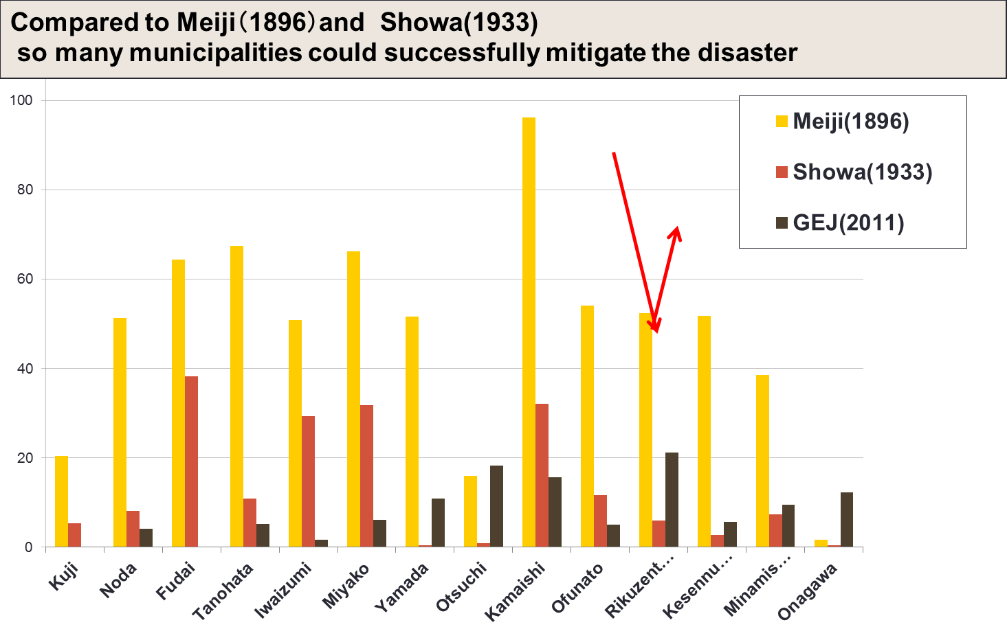
Approaches ①Past Experiences
HVR (%)
Iwate
Miyagi
Why do they reverse the historical trends? Did they learn from the experience?

Slide 11
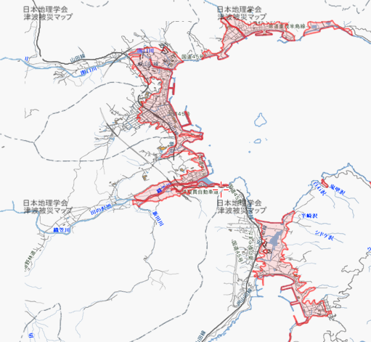
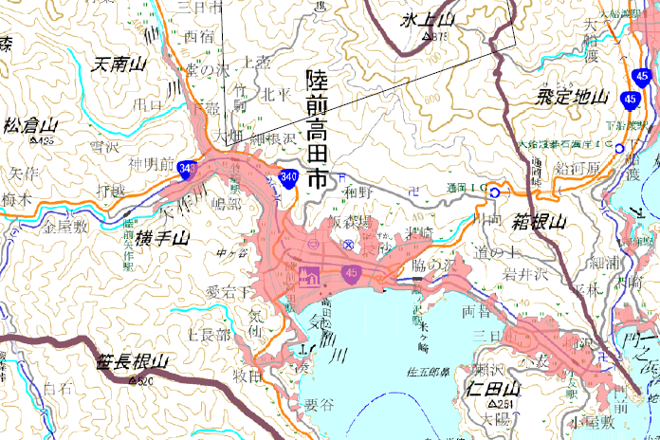
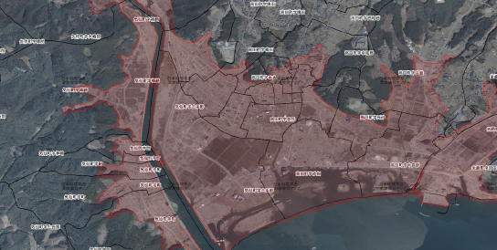
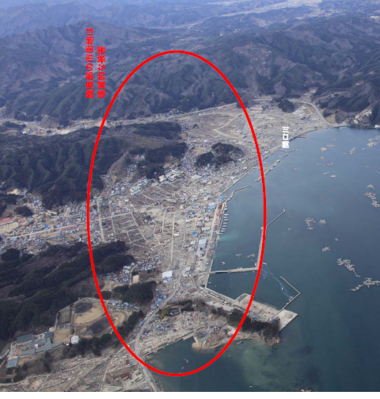
Yamada town and Rikuzentakata city
Rikuzentakata city
Yamada town
Approach ② Age Structures
Approach ③ Evacuation Conditions

Slide 12
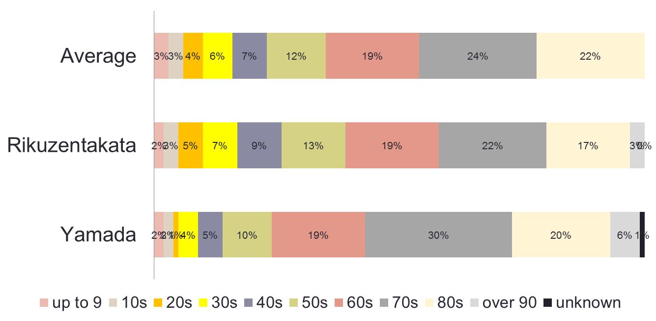
Approaches ② Age Structures
Age Structures of Reported Death
 | Over 60s in Reported Total Dead
3 Pref. Average | 65％
Rikuzentakata | 61％
Yamada | 75％

Slide 13
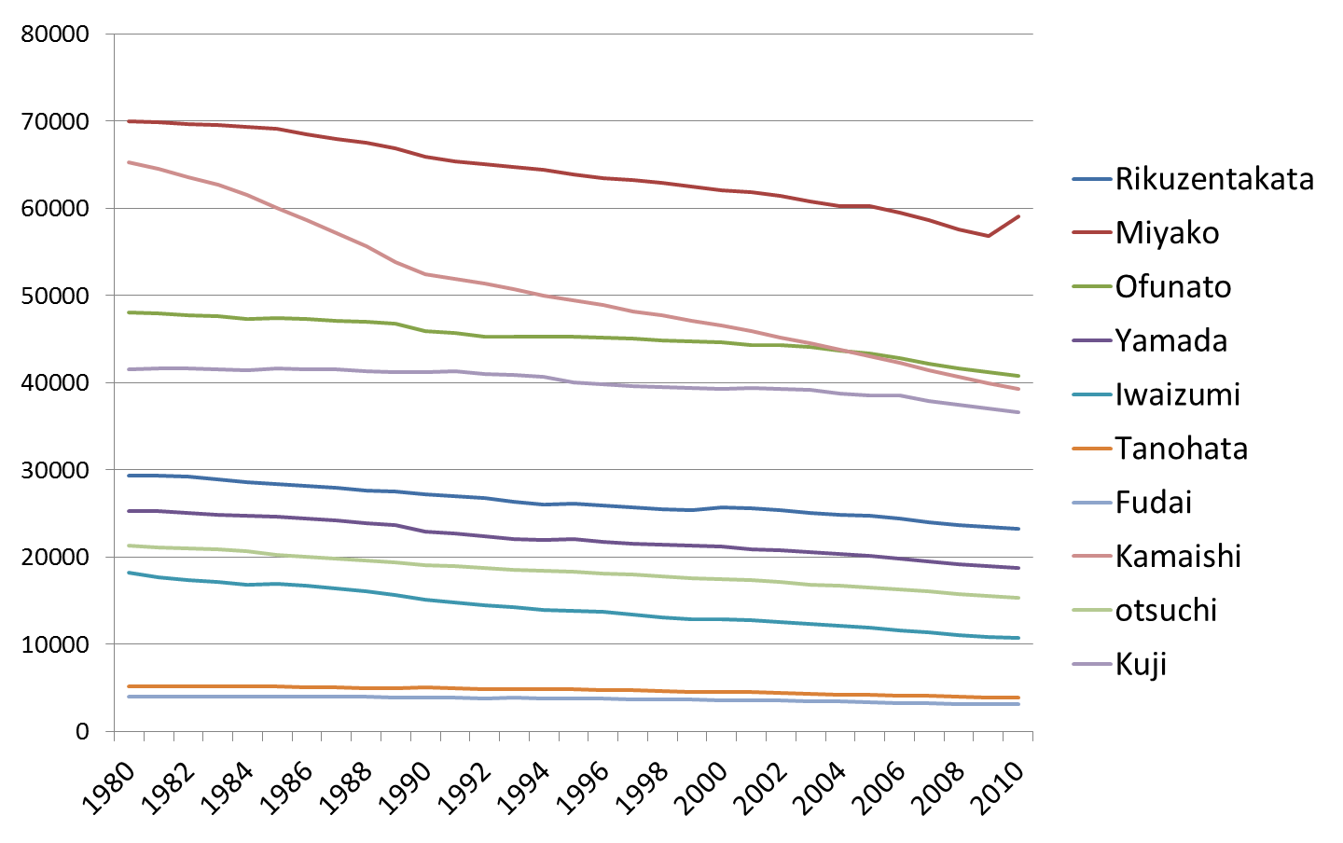
Approaches ② Age Structures
21% ▼
26%▼
Miyako,Ofunatos, and Kuji are included estimations by the impact of annexation.
<miyako (2005.6.6) ofunato (2001.11.15)>
Notes:
Showa
Learned from Meiji,
Even night time they evacuated
Some local communities moved to higher land after the meiji sanriku tsunami(1896)
13

Slide 14
Approaches ② Age Structures
 | Percentage of HH with Elderly Persons over 65
 | Yamada Town | Rikuzentakata City | Coastal Area Ave. | Iwate Pref.
Present <Year> | 57.4 <2006> | 62.8 <2006> | 54.3 <2006> | 46.1 <2006>
Change Ratio | ＋26％▲ （2004 -2006） | ＋16％▲ （2004-2006） | ＋25%▲ （2004-2006） | ＋19%▲ （2004- 2006）

Slide 15
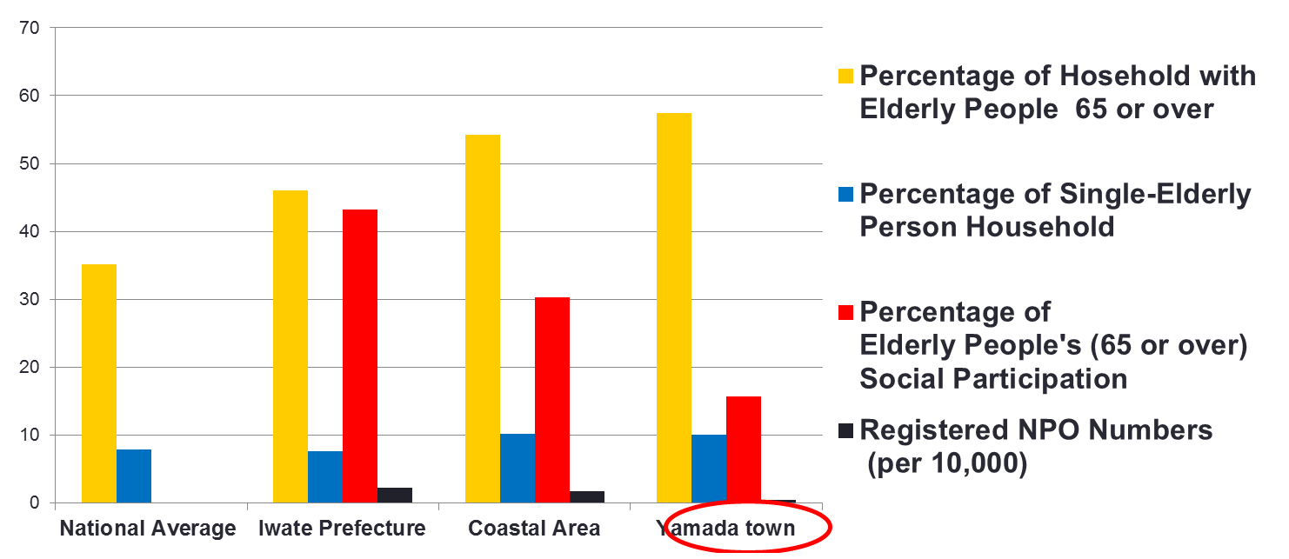
Approaches② Age Structures
Aging society with less social participation

Slide 16
Yamada town and Rikuzentakata city
Rikuzentakata city
Yamada cho
Approach ② Age Structures
Approach ③ Evacuation Conditions

Slide 17
Approaches ③Evacuation Conditions
Areas | Total Population | Dead | Ratio (%) | Missing | Ratio (%)
Yahagi | 1793 | 18 | 1 | 4 | 0
Yokota | 1405 | 14 | 1 | 2 | 0
Takekoma | 1291 | 38 | 3 | 4 | 0
Kesen | 3480 | 194 | 6 | 65 | 2
Takata | 7601 | 879 | 12 | 298 | 4
Yonezaki | 2902 | 82 | 3 | 32 | 1
Otomo | 2025 | 45 | 2 | 17 | 1
Hirota | 3749 | 42 | 1 | 16 | 0
Total | 24246 | 1312 | 5 | 438 | 2
Increasing Population in High Risk Area
Rikuzentakata city 2011.7.11

Slide 18
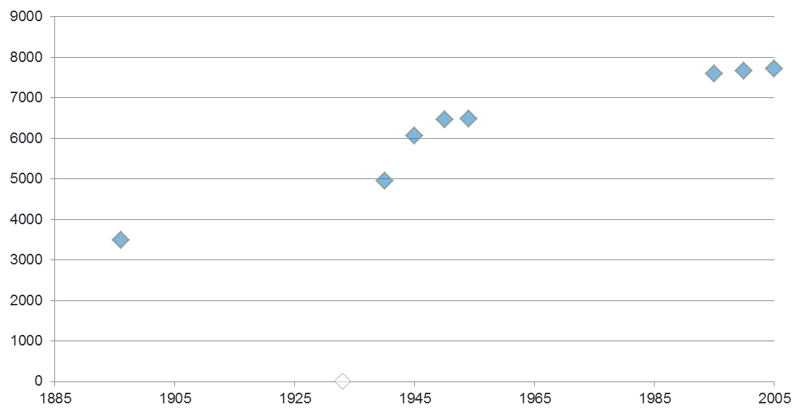
Approaches ③Evacuation Conditions
Takaｔa – area (high risk area)s population
Year | 1896 | 1940 | 1945 | 1950 | 1954 | 1995 | 2000 | 2005
Pop. | 3,489 | 4,960 | 6,060 | 6,461 | 6,488 | 7,605 | 7,663 | 7,711
Meiji(1896)
Showa(1933)

Slide 19
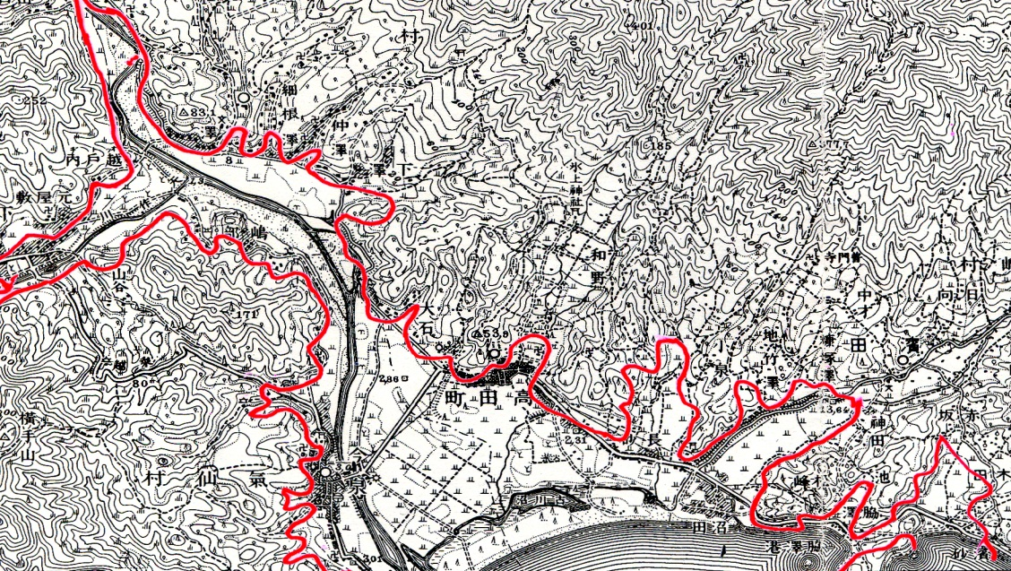
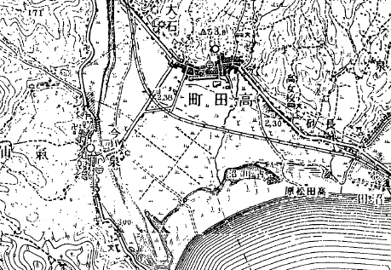
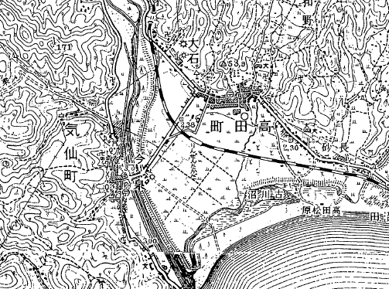
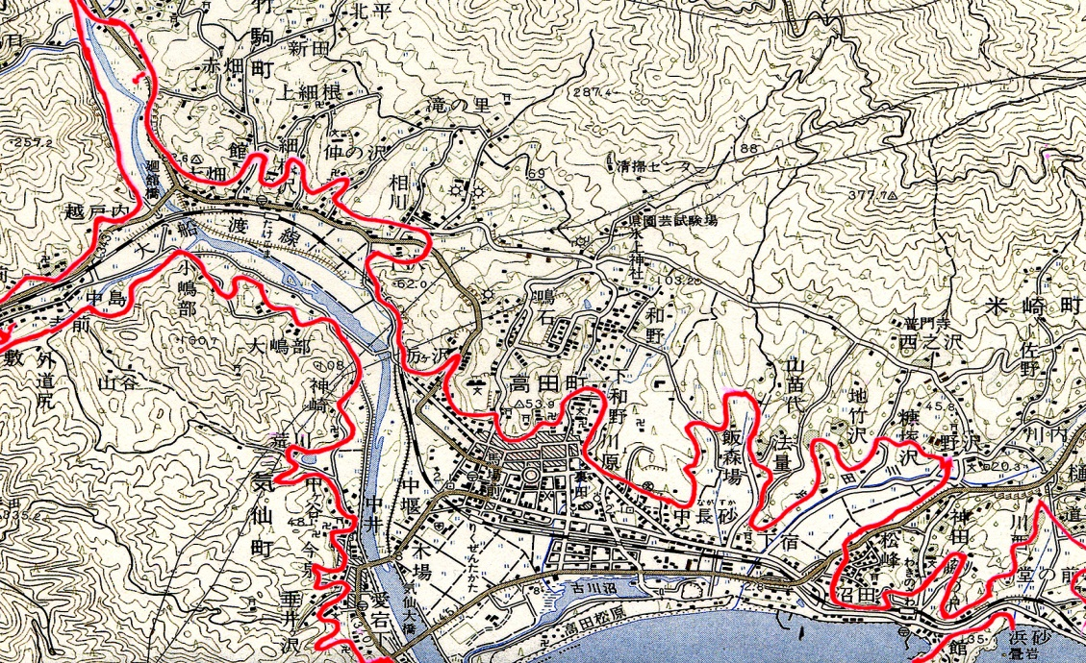
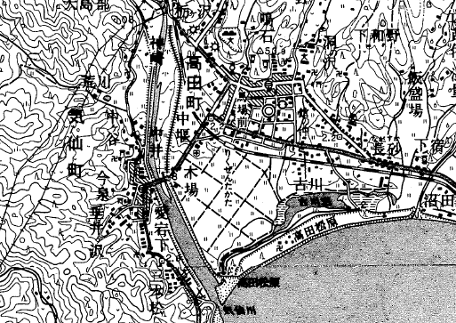
Approaches③ Evacuation Conditions
1913年
1933年
陸前高田 市街地の変化
1952年
2000年
1968年
1960-1966 Tsunami Project

Slide 20
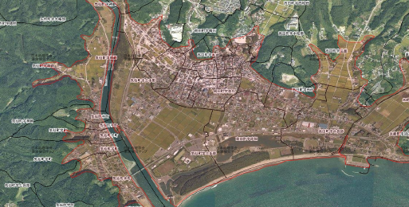
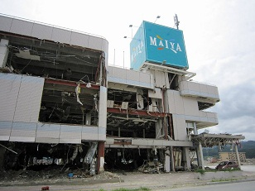
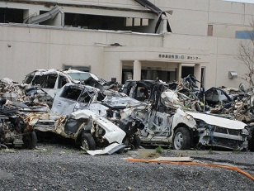
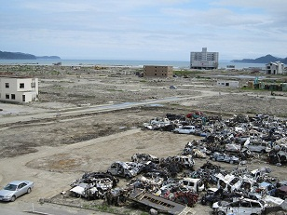
Approaches ③Evacuation Conditions
Before
After

Slide 21
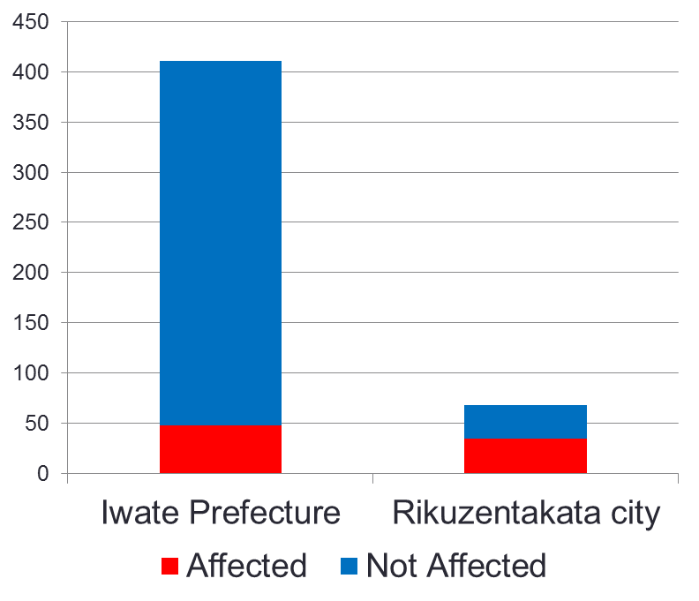
Approaches ③Evacuation Conditions
Affected Primary Evacuation Center
Primary Evacuation Centers | Iwate Prefecture | Rikuzentakata city
Total Numbers | 411 | 68
Affected | 48 | 35
Affected Ratio | 11.7 % | 51.5 %
TOPICS :
In the Takata area (high risk area) , Rikuzentakata city ， 70-80 evacuated and only 3 survived at Civic Gymnasium.
(Source : Kahoku Shinbun)

Slide 22
Conclusion (Try to answer the first 3 inquiries)
Why some municipalities had high human losses and the others less?
Where those differences come from?
Identify the Uniqueness of High Human Losses of Particular Municipalities
Methods : Meta and Longitudinal Analysis
- Development of the HVR.
- Surveys of literatures, statistical data sets, and maps.
Findings:
Yamada town : Aging society with low social participation
especially since 1980s
Rikuzentakata city : Increasing pop. in high risk areas,
especially after the last tsunami
Combination with critical cause analysis should be
implemented to investigate more detail

Slide 23
Suggestion for Decision Making from this study
Counter-measures for Aging Society
should be considered the impact of elderly population.
elderly people is difficult to evacuate.
so many people tried to help elderly people and affected.
2. Land Use Regulation
should be recognized past tsunami experience.
land use is one of the most effective way for disaster management
Not based on last tsunami but consider every historical tsunami
3. Education and Training
should be noticed the importance of education and training
School played a key role in GEJET
Difficult to pass down the experience over generations.
Tend to rely on the infrastructure as time passes.
4. Evacuation Planning
should be remarked the location of evacuation centers and related
planning
These should be considered based on “Worst Case Scenario”

Slide 24
Ｍａｎｙ Ｔｈａｎｋｓ
ICHARM International Centre for Water Hazard Risk Management under the auspices of UNESCO
CTI Engineering Co., Ltd. Japan
2011.７.21

