Slide 1
AWCI session, 12th AOGEO Symposium, 3/11/2019, Canberra, australia
[National report] platform on Water resilience and disasters in the Philippines
Mr. Michael T. Alpasan, DPWH
Mr. Socrates F. Paat Jr., DOST-PAGASA
Mr. Jonathan P. Victolero, DOST XI
Dr. Patricia Ann J. Sanchez, University of the Philippines Los Banos

Slide 2
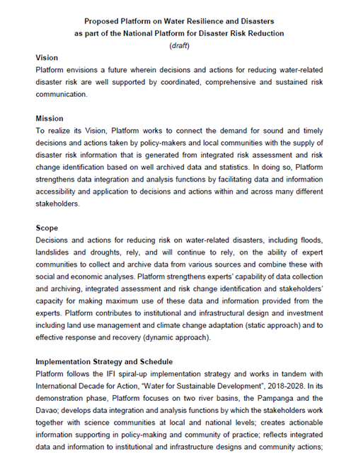
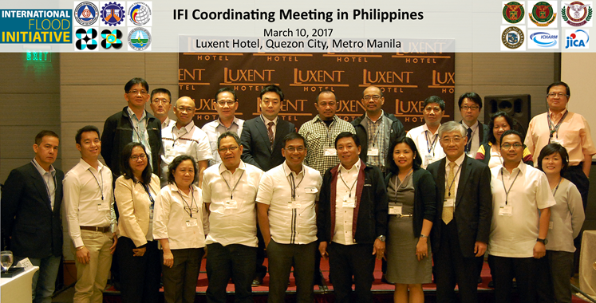
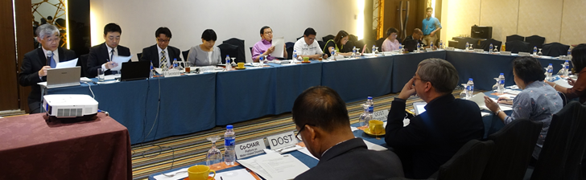
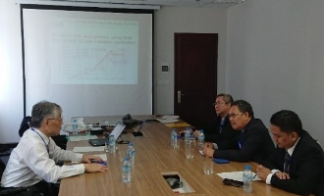
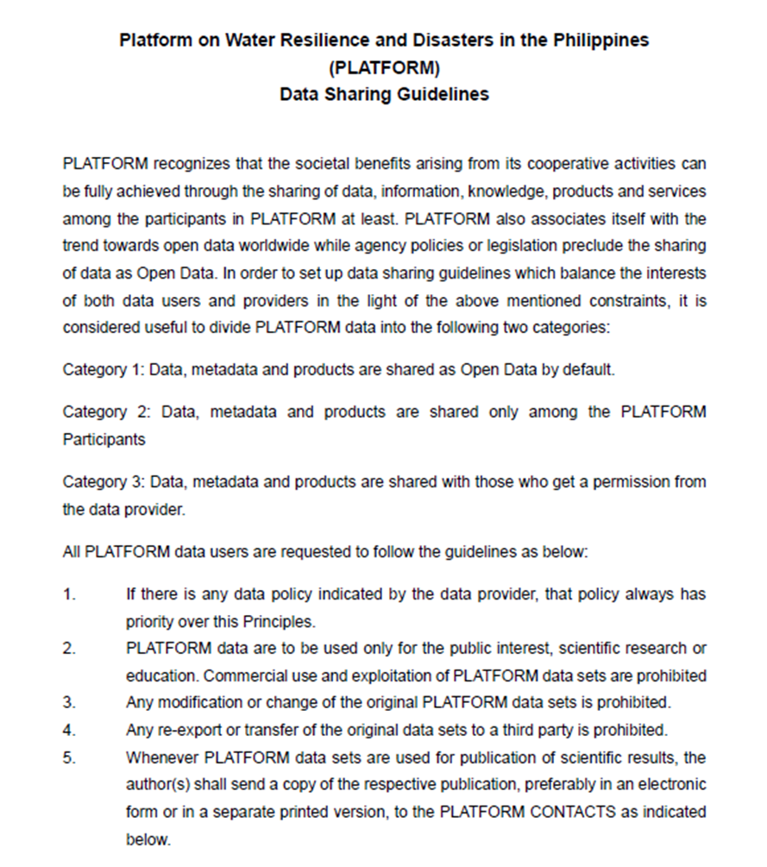
National report on the platform activity
Concept of Platform
Progress of Platform Activity
1st Plenary Meeting Concept sharing
13/3/2017, Metro Manila Platform formulation
2nd Plenary Meeting Data sharing guideline
15/6/2017, Metro Manila Data list creation
Representative Meeting Data list confirmation
18/9/2017, Hanoi
Individual Meeting Secretariat assignment
7-9/2/2018, Metro Manila Data collection
Individual Meeting Secretariat assignment
12-13/3/2018, Metro Manila HLPW outcome document
Stakeholders Meeting Data upload
18/5/2018, Davao
11th GEOSS Symposium Regional coordination
24-26/10/2018, Kyoto
3rd Plenary Meeting Activity update
7/2/2019, Metro Manila implementation
Michael-san
Data Sharing Guideline
Category 1:
Full open
Category 2:
Among Platform
Category 3:
With permission

Slide 3
National report on the platform activity
Agency | Office/Division
DPWH | UPMO-FCMC
 | Regional Office III
 | Regional Office XI
DOST | PAGASA
 | PHIVOLCS
 | PCIEERD
 | Regional Office II
 | Regional Office III
 | Regional Office XI
DENR | NAMRIA
 | Regional Office XI
DILG | WSSPMO-OPDS
DND | OCD
 | Regional Office XI
DSWD
LGA
MGB
NEDA | Regional Office III
 | Regional Office XI
NWRB
PSA
NIA
UP Los Banos
UP Diliman
UP Mindanao
Univ. of Tokyo | EDITORIA
ICHARM
Typhoon Committee
The 3rd Plenary Meeting of Platform
Michael-san
78 participants from 28 offices

Slide 4
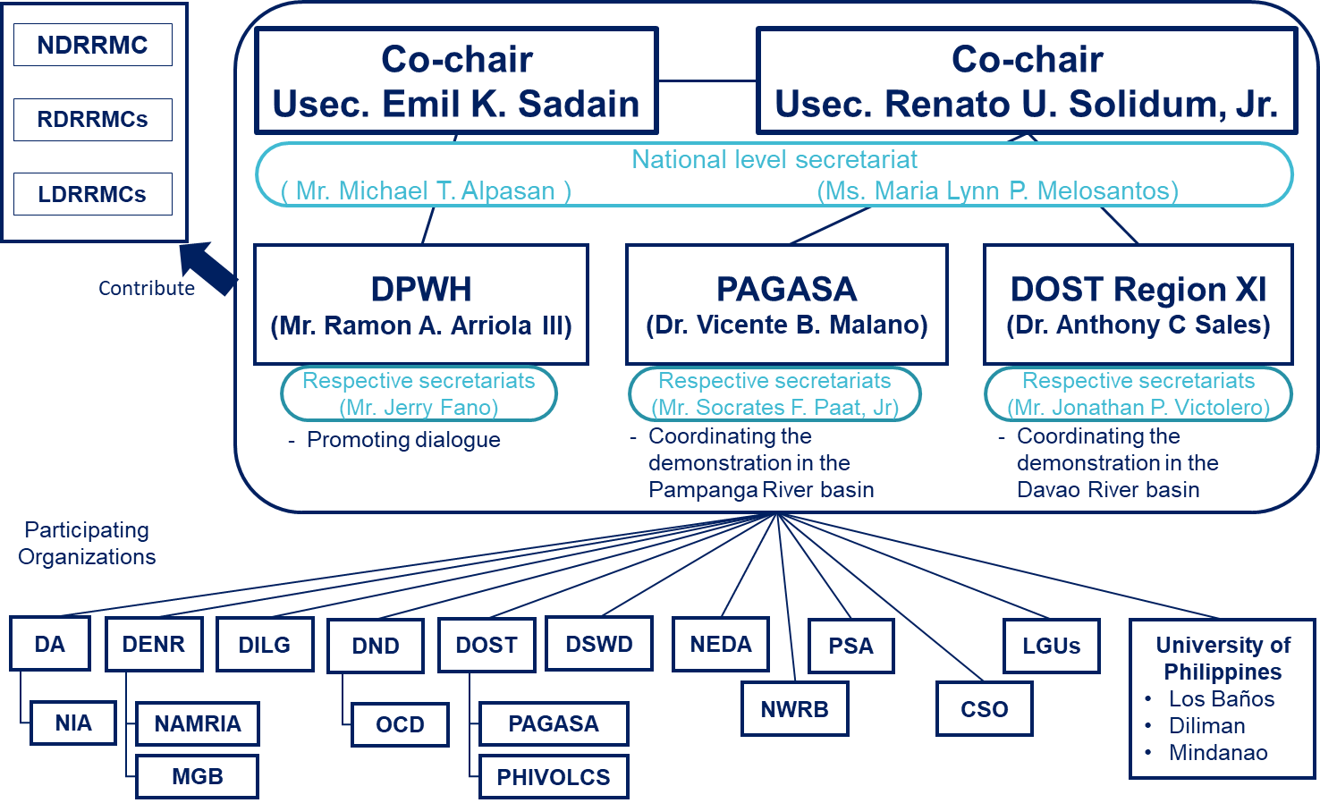
National report on the platform activity
Institutional Structure
Michael-san

Slide 5
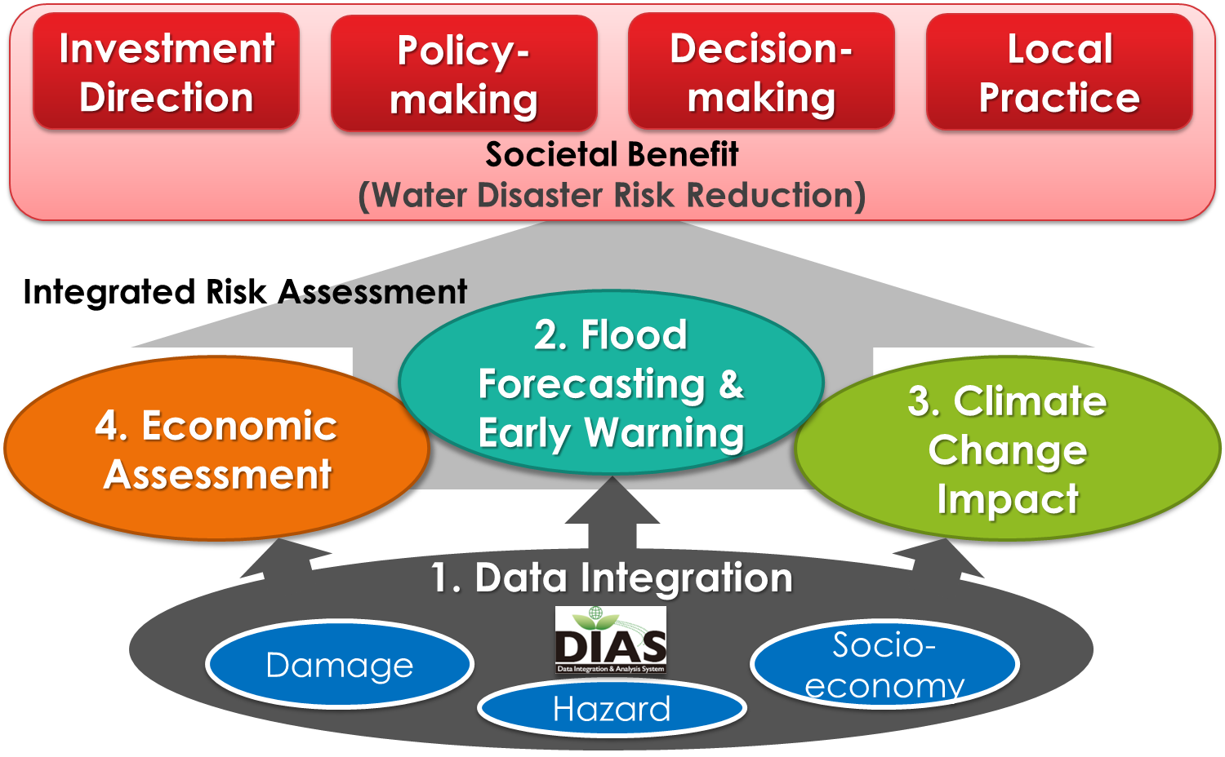
National report on the platform activity
Activity Plan
Michael-san

Slide 6
National report on the platform activity
1. Data Integration
Geospatial Authority
Economic Authority
Socio-economy
Damage
Hazard
Jonathan-san
Environment Depart.
Trade & Industry Depart.
Overall
Hydro-met Division
Sci. & Tech.
Depart.
Statistic Authority
LGU
River Bureau
Agricultural Depart.
Space Agency
Disaster Division

Slide 7
National report on the platform activity
Metadata Template
1. Data Integration
Damage
Hazard
Damage
Hazard
Socioeconomic
Socioeconomic
Data | Source of information
Casualties & missing person | OCD
Num. of affected people | OCD
Agricultural damage | DA
Housing damage | OCD
Damage to critical infrastructure | DPWH, LGU
Direct economic loss other than agricultural loss | LGU NEDA
Data | Source of information
Land use | LGU, DOST
Agriculture | PSA, DA
Population | PSA
Infrastructure | DPWH/LGU
Industry | DTI
Commerce | DTI
Drainage facility | DPWH/LGU
Information | PSA, NEDA
Sectoral Regional GDP | PSA
Sectoral employed population | PSA
Tax revenue | BIR
Land price | City Assessors Office
Jonathan-san
Data | Source of information
Casualties & missing person | OCD
Num. of affected people | OCD
Agricultural damage | DA
Housing damage | OCD
Damage to critical infrastructure | DPWH, LGU
Direct economic loss other than agricultural loss | LGU NEDA
Data | Source of information
DEM (LiDAR) | UP Mindanao
DEM (ifSAR) | NAMRIA
Hydromet data | PAGASA, ASTI, DREAM
Inundation depth (LiDAR) | UP Diliman, UP Mindanao
Inundation depth (interview) | PAGASA
Rainfall | PAGASA
River flow | DPWH, UP Mindanao
River cross section | DPWH, UP Mindanao
Tidal level | NAMRIA
Data | Source of information
Land use | LGU, DOST
Agriculture | PSA, DA
Population | PSA
Infrastructure | DPWH/LGU
Industry | DTI
Commerce | DTI
Drainage facility | DPWH/LGU
Information | PSA, NEDA
Sectoral Regional GDP | PSA
Sectoral employed population | PSA
Tax revenue | BIR
Land price | City Assessors Office
Data | Source of information
DEM (LiDAR) | UP Mindanao
DEM (ifSAR) | NAMRIA
Hydromet data | PAGASA, ASTI, DREAM
Inundation depth (LiDAR) | UP Diliman, UP Mindanao
Inundation depth (interview) | PAGASA
Rainfall | PAGASA
River flow | DPWH, UP Mindanao
River cross section | DPWH, UP Mindanao
Tidal level | NAMRIA
Collected

Slide 8
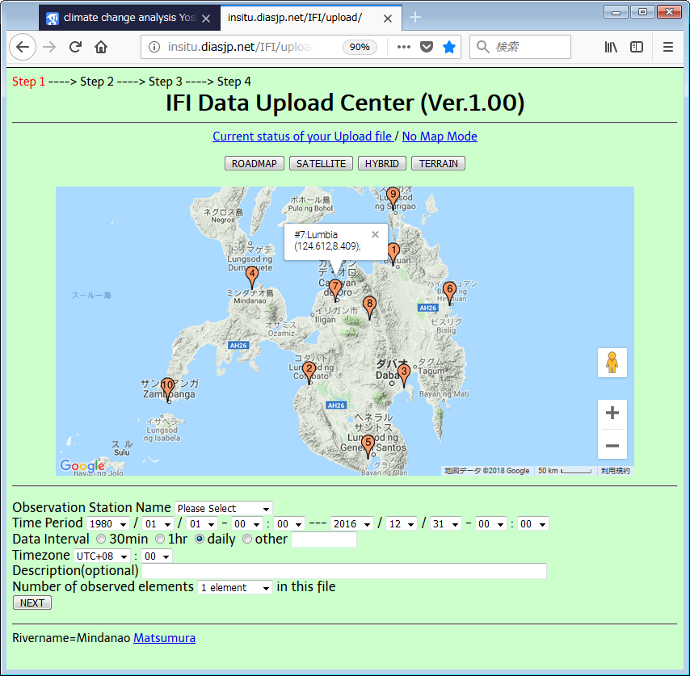
National report on the platform activity
1. Web-based Data Uploading System
Input Item;
Data Domain, Area, District :
Category:
Data Source
Data Type
Period
Resolution
Jonathan-san

Slide 9
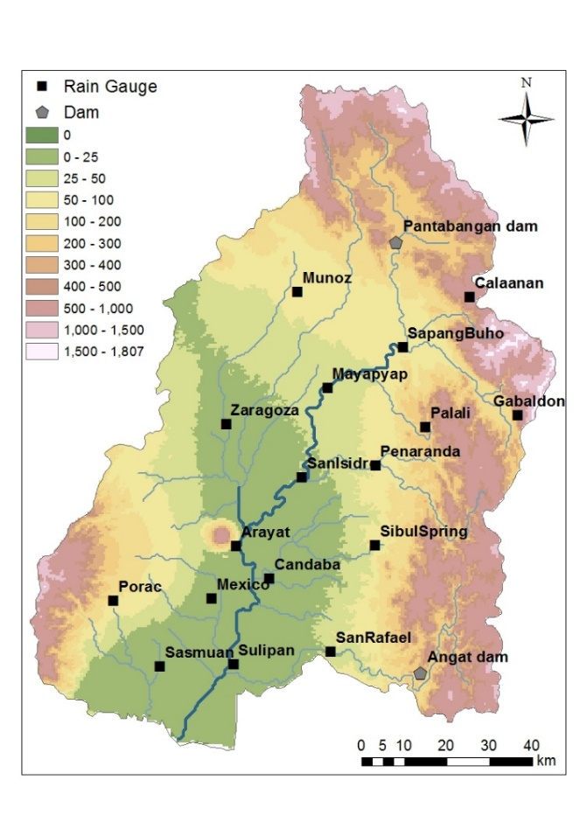
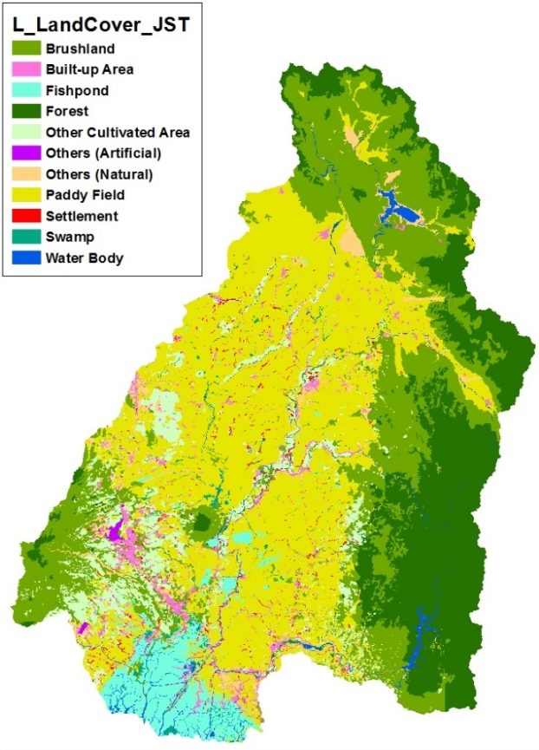
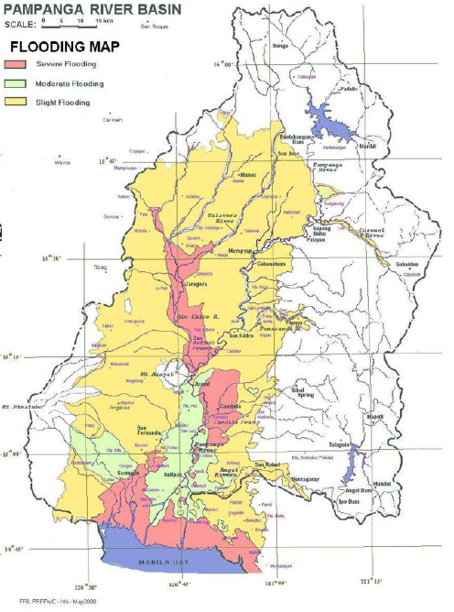
National report on the platform activity
2. Flood Forecasting & Early Warning
Pampanga River basin
Catchment Area: 10,434km²
River Length: 260km
Annual Rainfall: 2,155ｍｍ
Rain Gauge: 17 stations
Water Level: 11 stations
Jun-san
Observation
Land use
Flood vulnerability

Slide 10
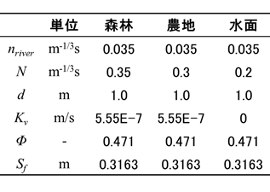
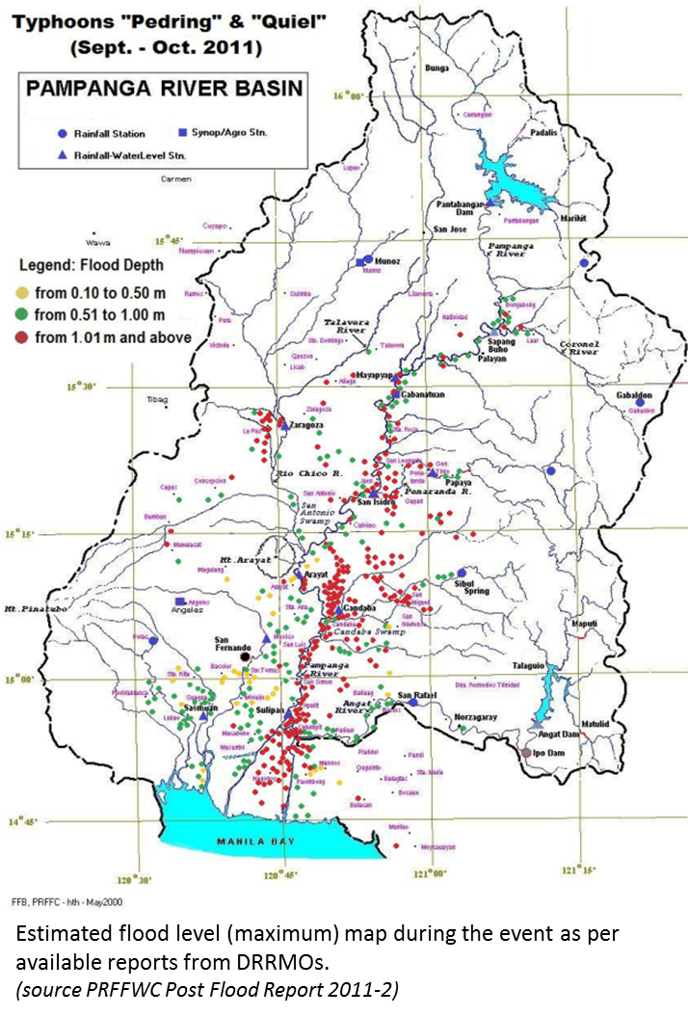
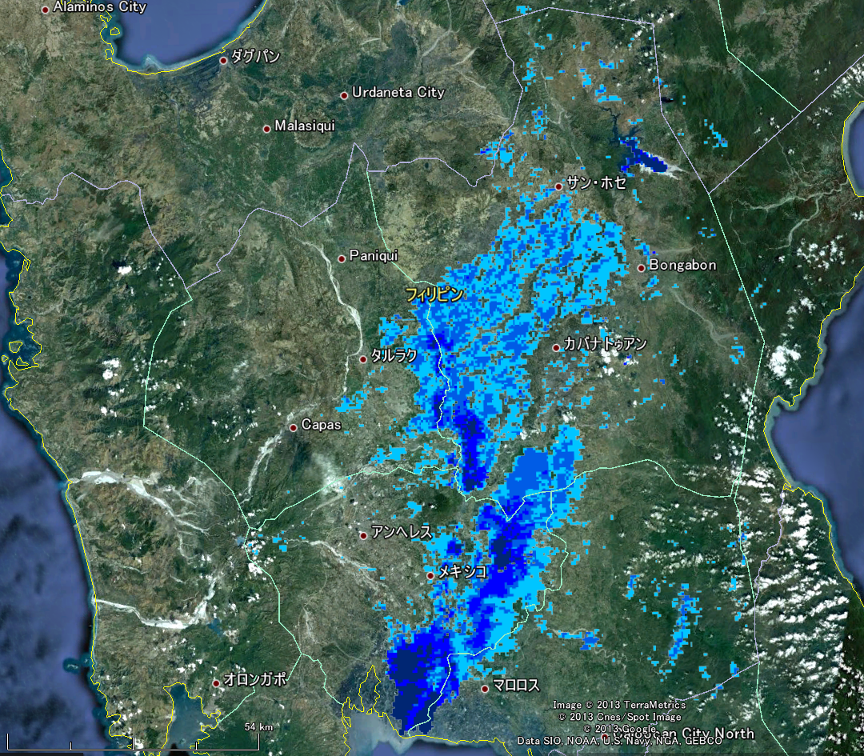
National report on the platform activity
2. Flood Forecasting & Early Warning (Model Calibration)
Unit forest crop water
Jun-san
MODIS 8days composite
NSE= 0.63
NSE= 0.68

Slide 11

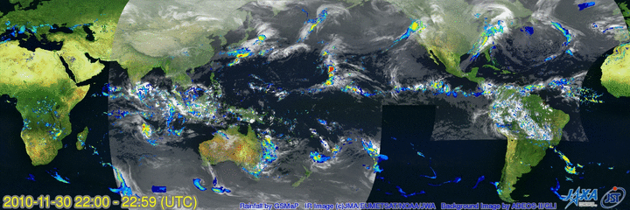
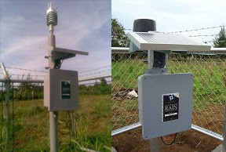
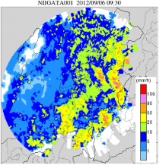
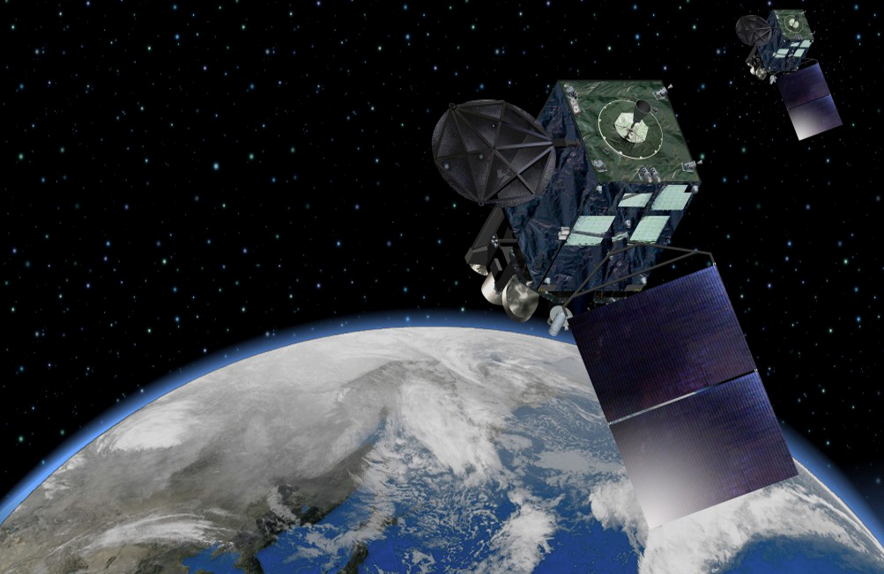
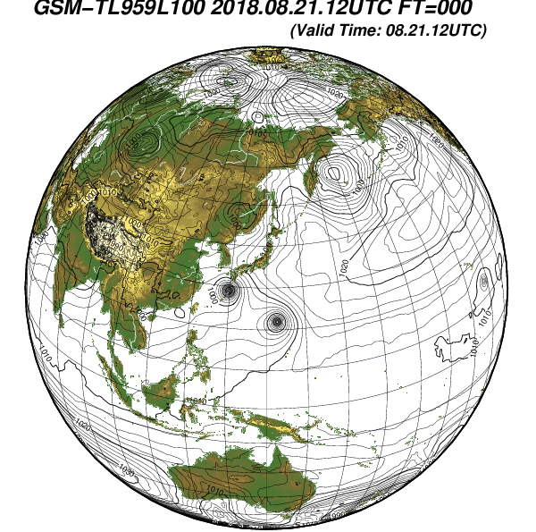

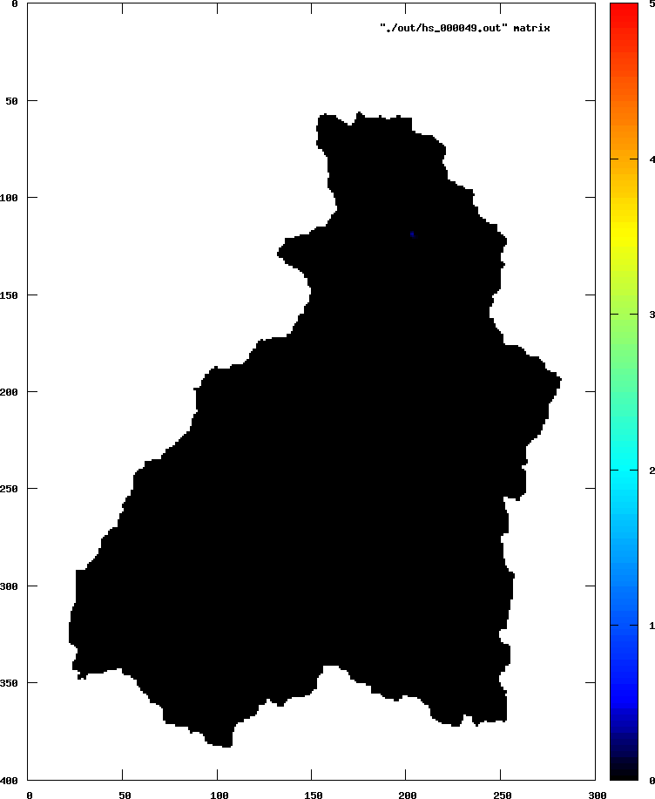
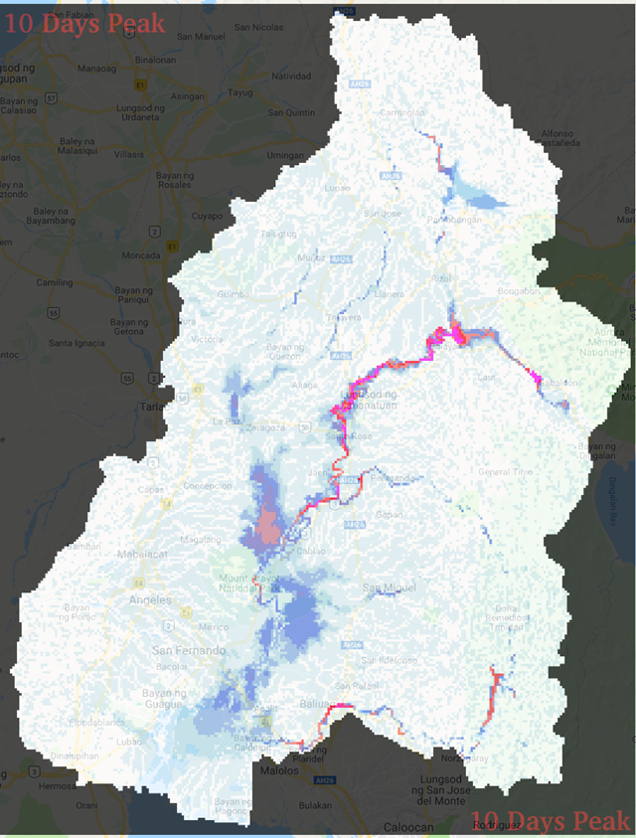
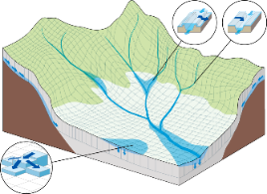
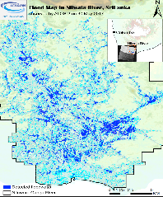
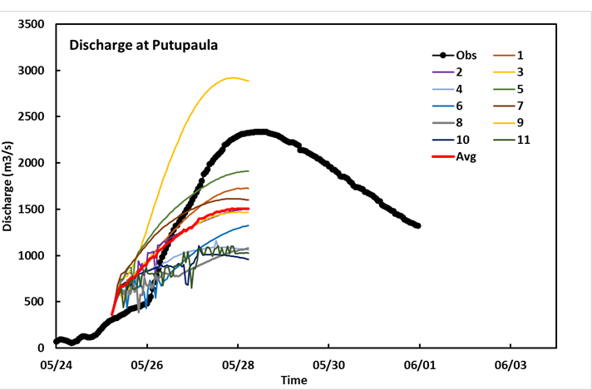

National report on the platform activity
2. Flood Forecasting & Early Warning (Full Design)
Numerical Weather Prediction
Satellite Rainfall
GSMaP
In-situ
Gauge
In-situ
Radar
Cloud Image
HIMAWARI-8
Jun-san
Dam Operation
Forecasting
RRI Model
Simulation
Satellite Image
ALOS-2
Monitoring
Flood prevention & evacuation
Inundation extent
Inundation depth
River discharge
ALOS © JAXA (2016)

Slide 12
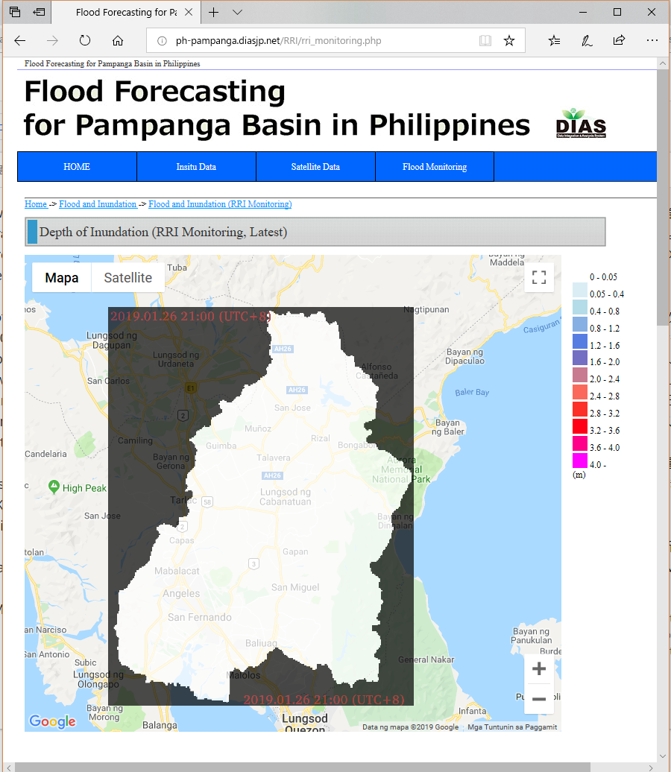

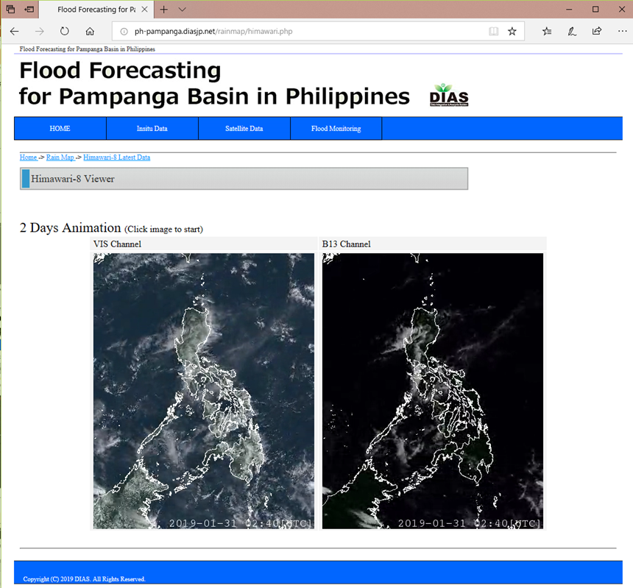
National report on the platform activity
2. Flood Forecasting & Early Warning (Preliminary)
In-situ
Gauge
PAGASA
Server
Jun-san
Authorized
Part
Satellite Rainfall
GSMaP
Realtime Access
Cloud Image
HIMAWARI-8

Slide 13
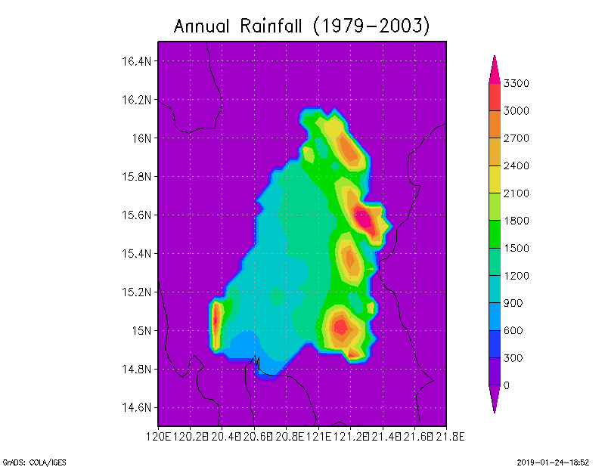
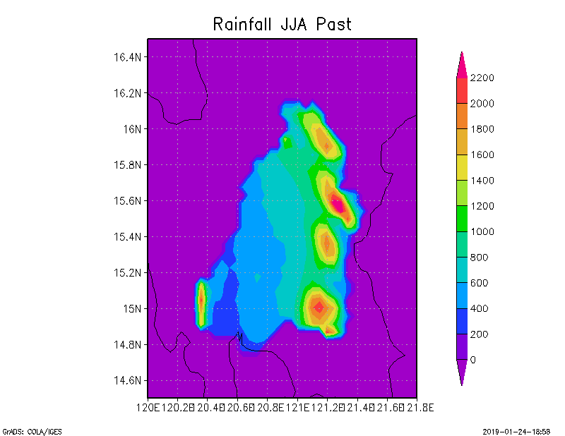
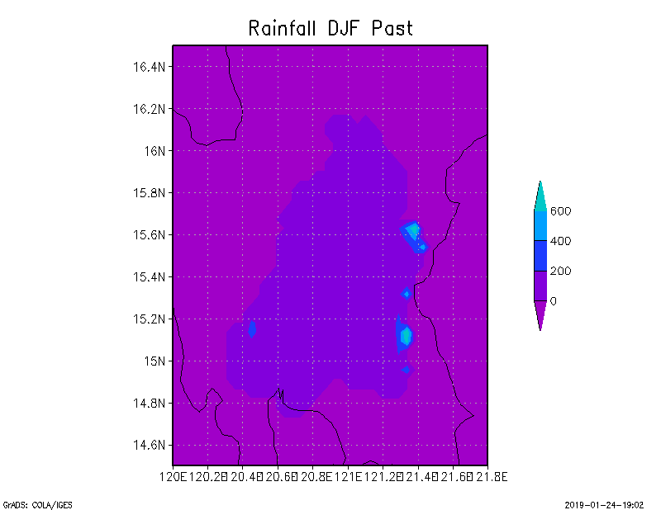
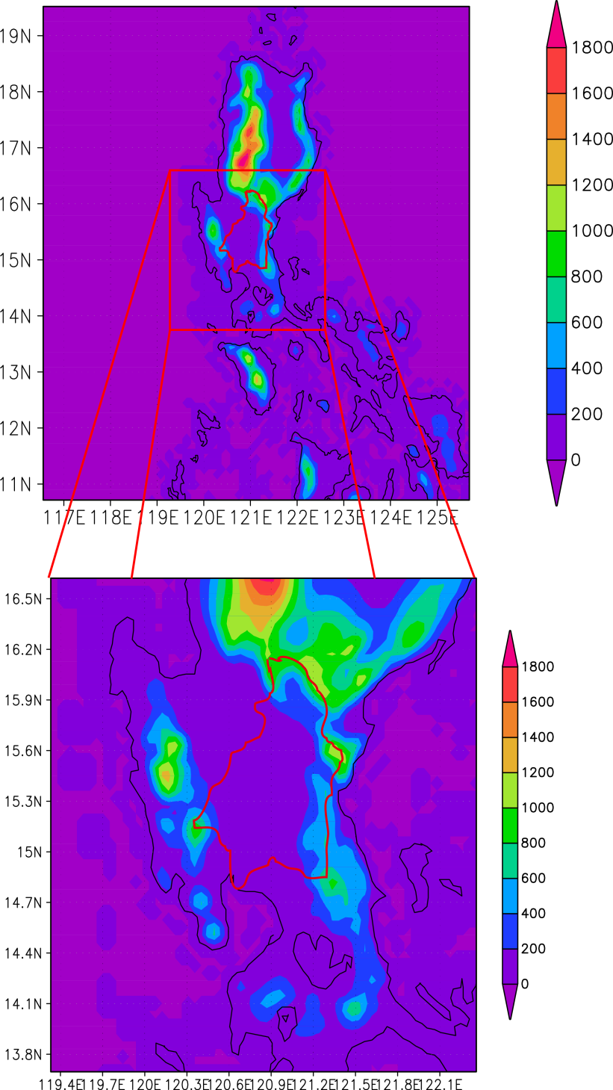
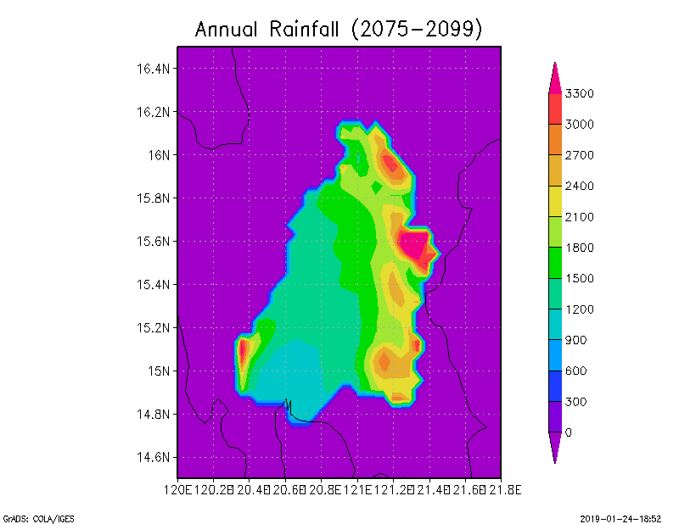
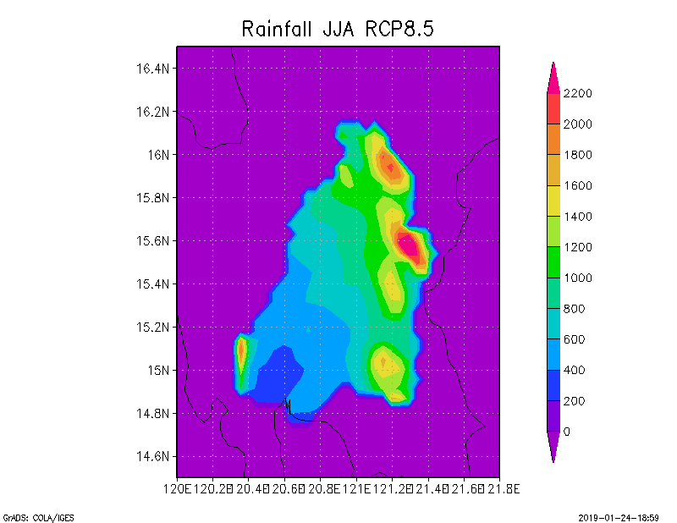
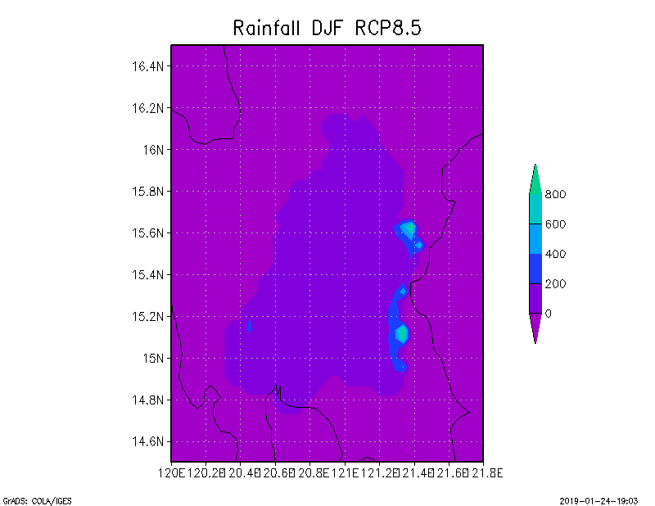
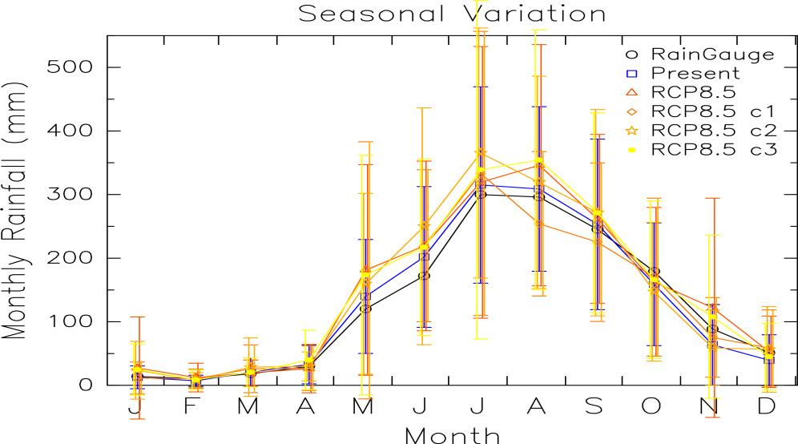
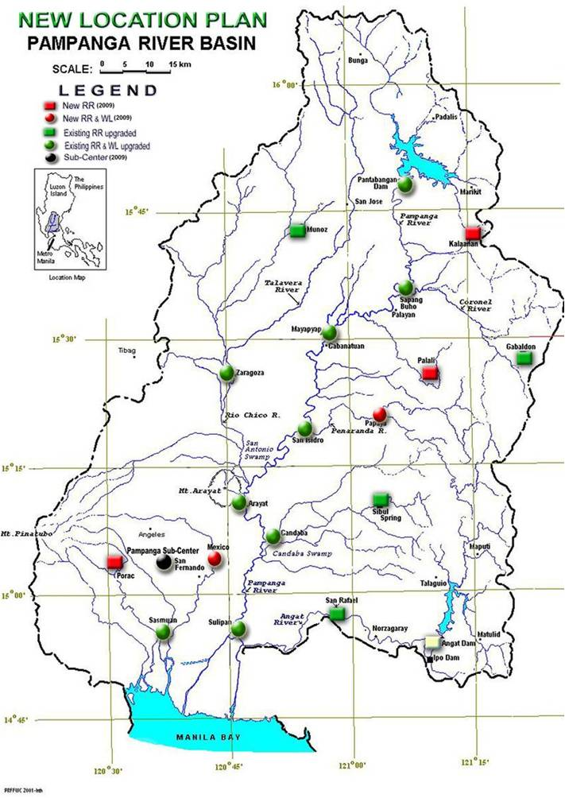
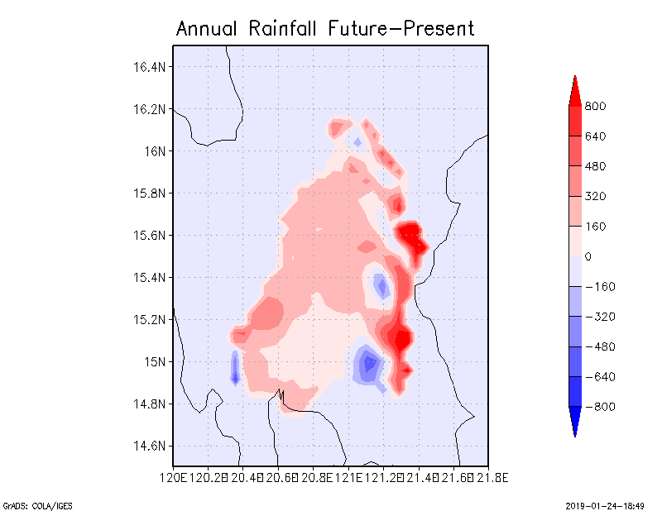
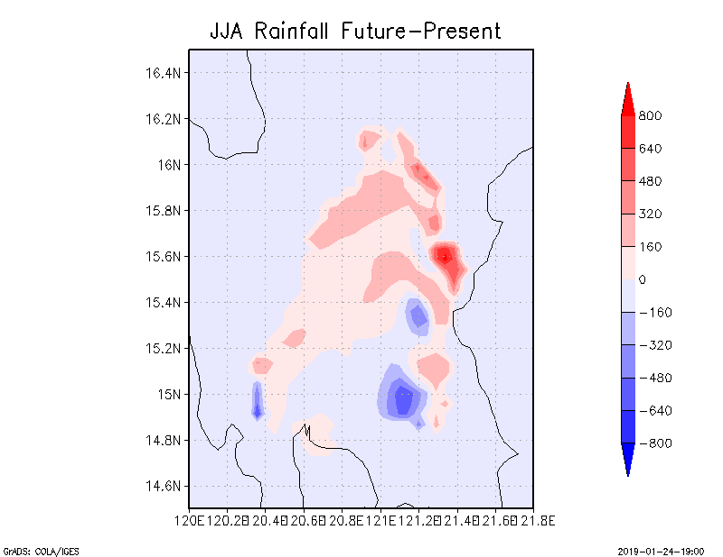
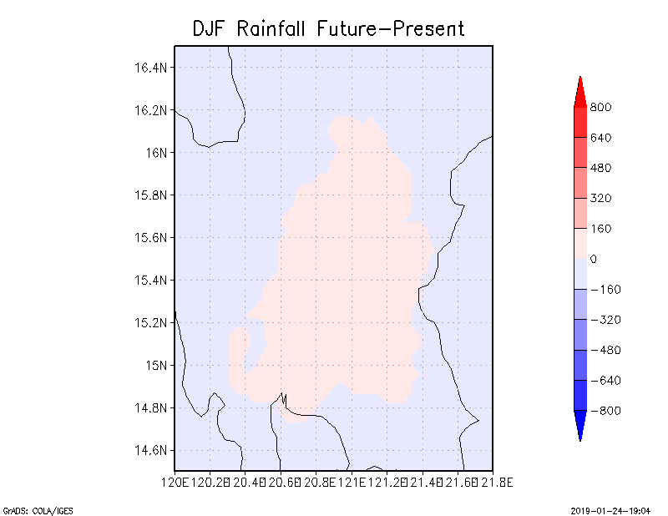
National report on the platform activity
3. Climate Change Impact (Pampanga River Basin)
Annual total
JJA
DJF
Weather Research and Forecasting (WRF) ver.3.4.1
Horizontal resolution: 15km/ 5km
Coordinate: 67×67×40 (outer), 67×67×40 (inner)
Cumulus parameterization: Grell 3D
Microphysics: WSM3class
PBL scheme: MYNN2.5
Surface: Thermal diffusion
Jun-san
Past climate
Future climate
RCP8.5
Difference (future)-(past)
Seasonal Variation of Rainfall
(a little increase, but not much)
Rain gauges
Rainfall distribution in past and future climate
Pampanga River Basin
46% increase of 1/50 extreme rainfall ⇒One flood event causes more damage

Slide 14
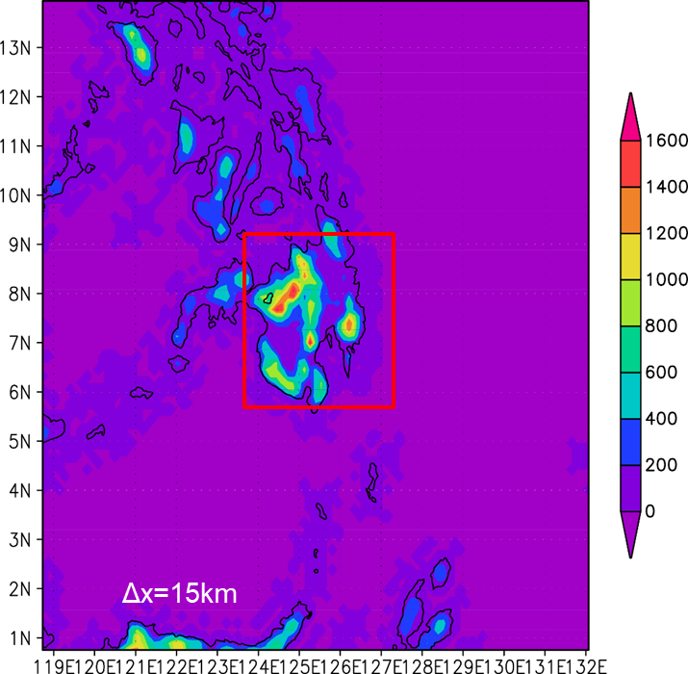
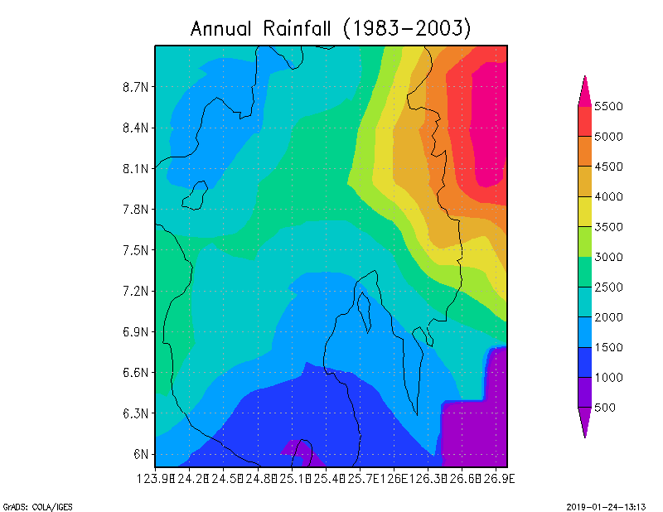
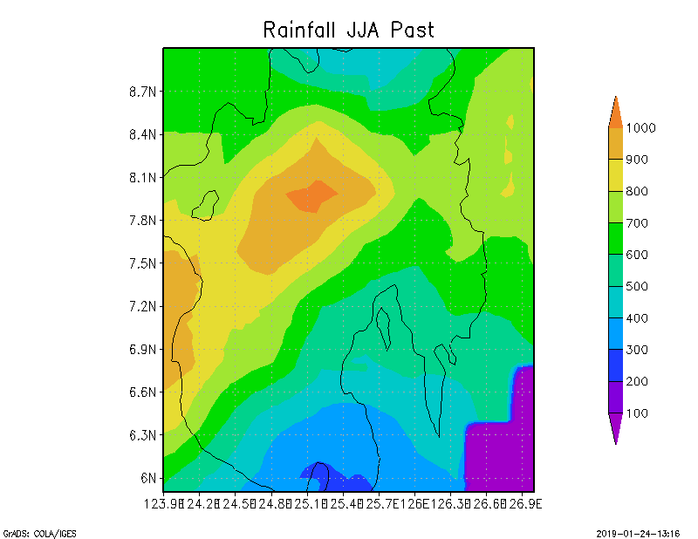
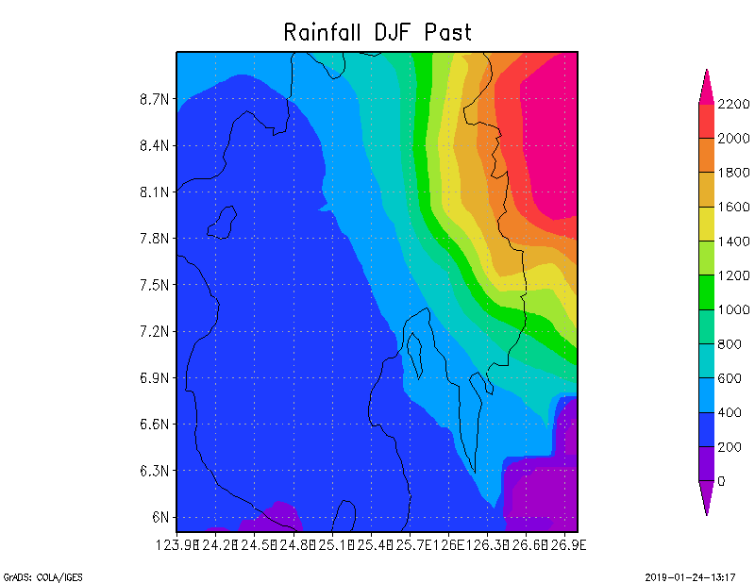
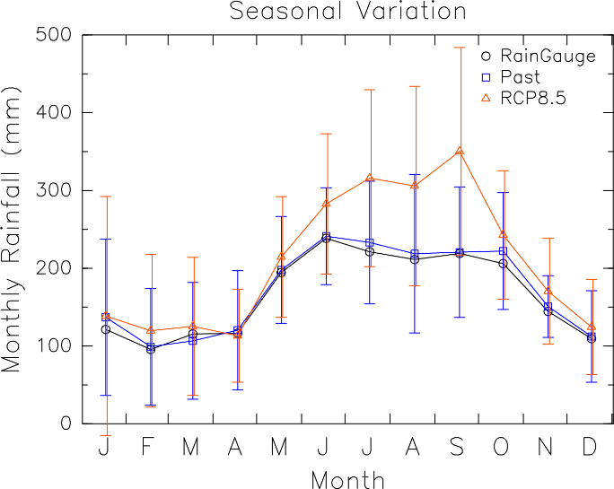
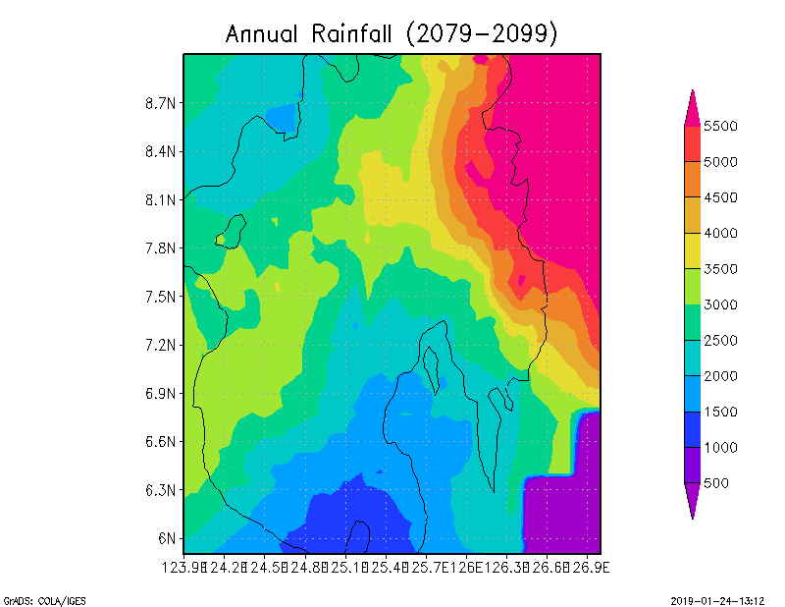
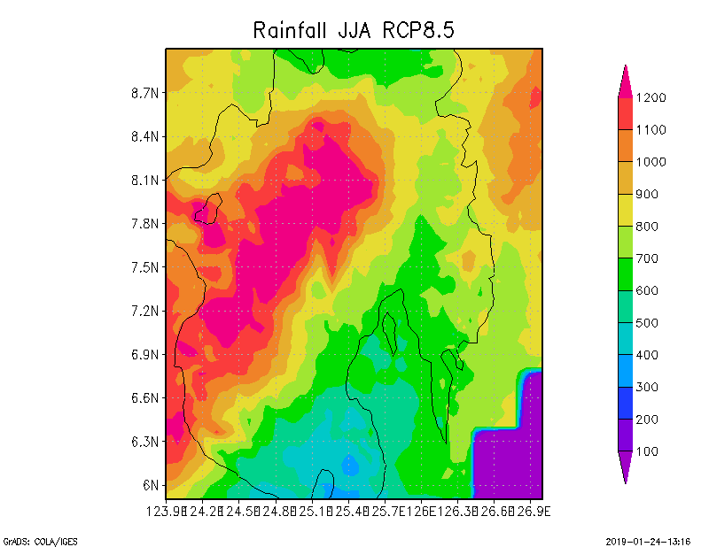
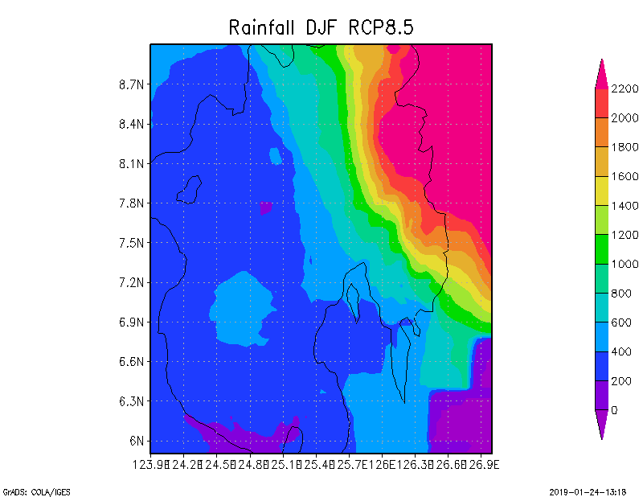
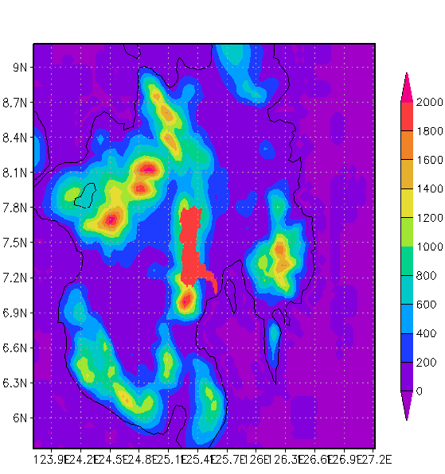
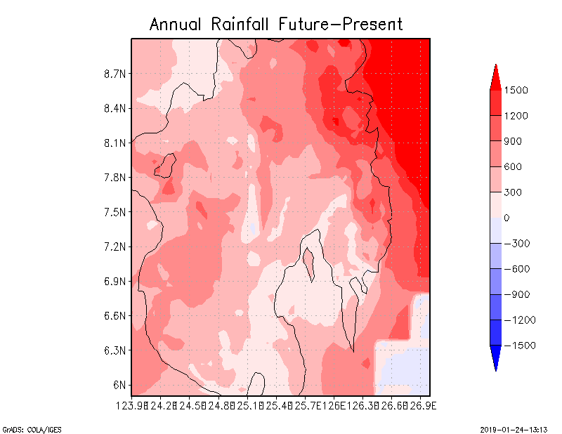
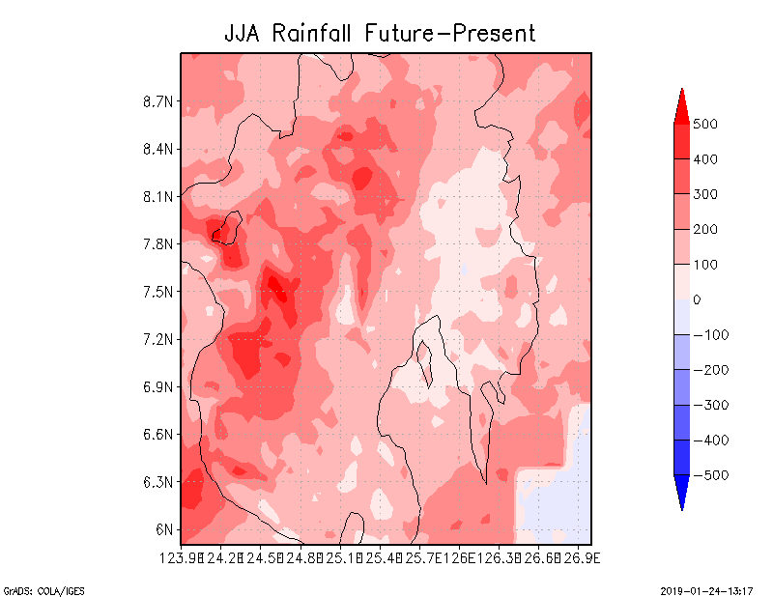
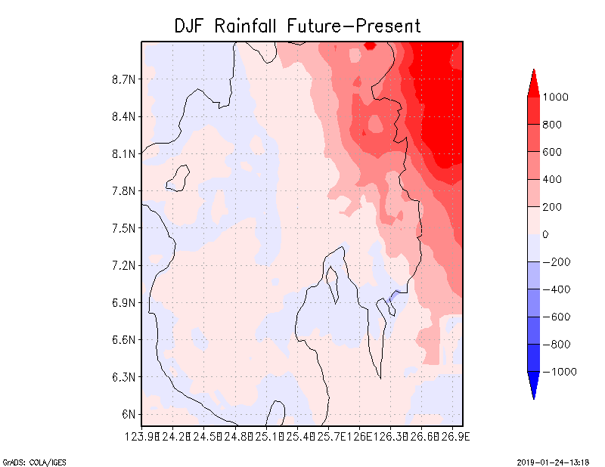
National report on the platform activity
3. Climate Change Impact (Davao River Basin)
Annual total
JJA
DJF
WRF model setting
Outer frame: 15km, 100x100
Inner frame: 5km, 79x79
Vertical layer: 40
Cumulus: Grell 3D
Jun-san
Past climate
Raingauge
Past Climate
Future Climate (RCP8.5)
Future climate
RCP8.5
Davao River
Area: 1623 km²
Length: 160 km
Difference (future)-(past)
Seasonal Variation of Rainfall
(increase during July to September)
Δx=5km
Rainfall distribution in past and future climate
33% increase of 1/50 extreme rainfall & July-September rainfall increase 45% ⇒Average discharge increases + one flood event causes more damage

Slide 15
National report on the platform activity
4. Economic Assessment
Private Capital Stock
Kp
Production
（GRP:Gross Regional
Product）
Y
Patricia-san
100%
Build Back Better
Production Function
Emergency Response
Damage of Depreciable Assets of Offices
Y=AKp^{α}L^{β}
Labor Force
L
Operational Ratio of Society
Resilience
Robustness
With countermeasures
Without countermeasures
Number of Days with business interruption and Delay Death due to disaster
⊿Y =Yafter－Ybefore =(AKafter^{α} L after^{β} )－ (AKbefore^{α} L before^{β} )

Slide 16





National report on the platform activity
5. Contingency Planning
Ordinary Flood (10 Years)
High Flood (30 Years)
Pampanga River Basin: Catchment Area: 10,434 km²
River Length: 260 km
Average annual rainfall:
2155 mm/year
Calumpit Municipality:
Population: 112,007
Barangay(Local community unit): 29
Households: 22,402
Area: 5,625 ha
Patricia-san
Extreme Flood (100 Years)
2011Typhoon Pedring
Interferometric Synthetic Aperture Radar (IfSAR) Data provided by NAMRIA, Philippines, was used in the calculation (grid size/ 5m).
Source: OCD-3/PRFFWC

Slide 17




National report on the platform activity
5. Contingency Planning
Total Score
District-base analysis
Google Earth Street View with inundation visualization
(High Flood Case)
Patricia-san
Identify the flood hot spots

Slide 18
Proposal of capacity development
Workplan of Capacity Development on Climate Change in Davao City
CC Orientation
Objective
- Contribution adaptation measures development
- Encouragement and coordination of multi-stakeholder engagement
Expected Output
- Activity design for CC adaptation
- Barangay-level damage data analysis
2. Platform Plenary Meeting
Objective
- Status sharing and update of the Platform activities among all members
- Discussion on further activities of Platform
Expected Output
- FF System for Davao RB
- Data integration examples
3. DIAS End-user Training
Objective
- To capacitate end-users on the know-how of DIAS
- To maximize the utilization of DIAS
Expected Output
- Data uploading by stakeholders
- Data integration products
4. Policy & Benchmarking WS
Objective
- Contribution to local policy-making on CC
- Best practice on the importance, applicability and usability.
Expected Output
- Policy proposal on CC adaptation to Mayor
- Community action
Jonathan-san
2020
Oct.
2019
Apr.
2020
2020

Slide 19










Proposal of capacity development
Activity Design
Experiencing Climate Change
Strengthening Resilience
Toward the Prosperous Davao
Jonathan-san
Climate change impact assessment based on S&T
Predict climate change impact and scenario
Design a brilliant future
Visualization
Resilient society beyond saving lives
Coordination with relevant ongoing energies
Be Climate Smart NOW
SAFE: S&T Action Frontline for Emergencies and Hazards Program
Groundwater use
Agriculture, Aquaculture and Natural Resources (AANR)
biodiversity
Evacuation
“Nudging” psychological process to disaster risk
Area BCM;
Business
Continuity
Management
Setting All
1/100 Flood (200m grid)
Experiencing Events
Infrastructure design
Resilient communities
Incentive for investment
Attractive policy proposal
Bright tomorrow of Davao

Slide 20
Proposal of capacity development
If any from DPWH
Michael-san

Slide 21
Proposal of capacity development
If any from PAGASA
Jun-san

Slide 22
Proposal of capacity development
If any from UPLB, maybe, SATREPS
Patricia-san

Slide 23
Roadmap/strategic way for global agenda
From each organization, because discussion on roadmap continues to afternoon session.
All of you

